Slide 1
Security

Slide 2
application
network
system
data
Motivation
for
Security

Slide 3
Application Security
Authentication – Http 401 - Unauthorized
Authorization – Http 403 – Access denied
Security

Slide 4
Form Login
HTTP Basic
LDAP
Biometrics/Retina
OTP/TOTP
Chip and Pin
MFA
NFC
Face-recognition
Kerberos
Certificates
RSA soft token
Oauth 2.0
Authentication

Slide 5
Path based
Method level Authorization
Authorization

Slide 6
Delegation based
Used Token for Authn and Authz
OAuth 2.0

Slide 7
Resource Owner
Resource Server
Authorization Server
Client application
Oauth 2.0

Slide 8
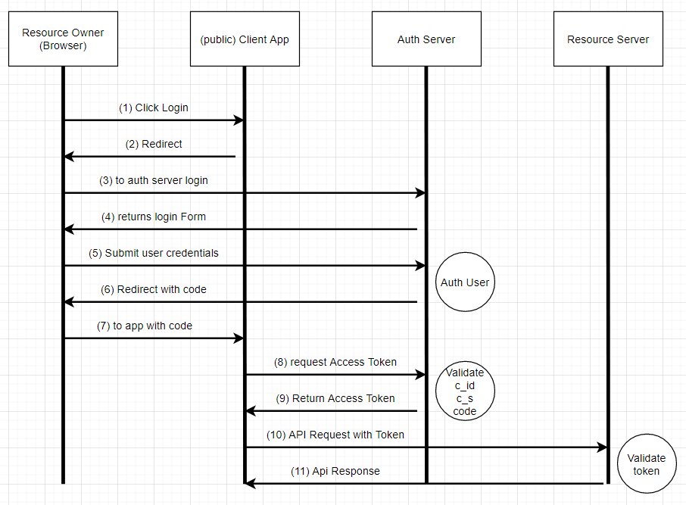
OAuth2.0 Auth_code

Slide 9
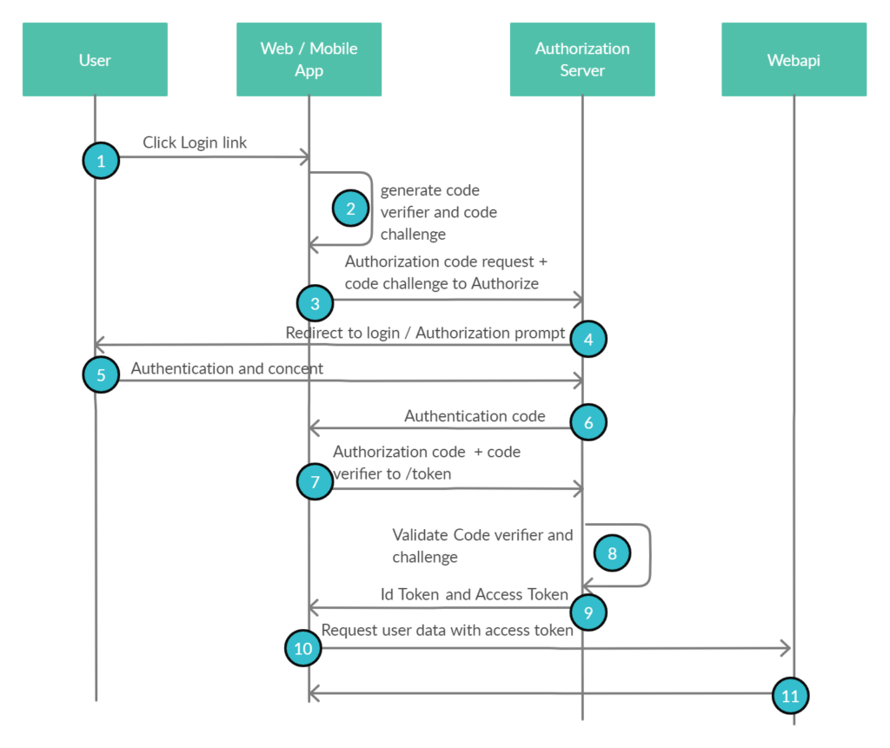
OAuth2.0 PKCE

Slide 10
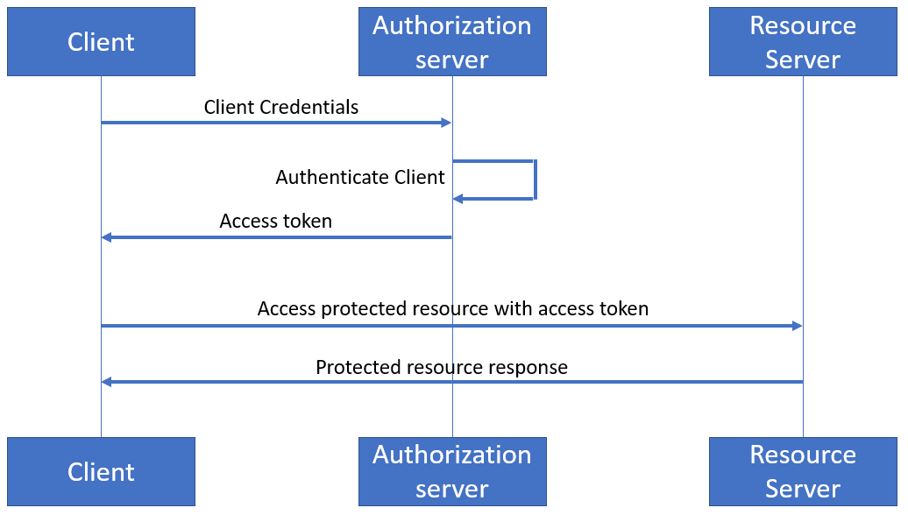
OAuth2.0
Client credentials

Slide 11
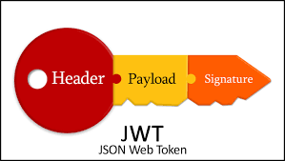
JSON Web Token

Slide 12
URI is public endpoint
JWK is a JSON object that represents a cryptographic key
JWKS has array of JWK
JWKS endpoint

